Slide 1

Pollock fishing for cell states

Slide 2
What’s Pollock
A single cell classification tool
Goals
Streamline single cell classification – i.e. no need to spend a long time manually clustering and annotating cell types
Make it easy to apply high quality, annotated cell types to other single cell datasets
Available as a Python library, R package, and command line tool

Slide 3
Outline
Pollock model details/architecture
Example: transferring snRNA-seq CCRCC immune cell types/states to snRNA-seq GBM
Demo

Slide 4
Single Cell Datasets
In-house
CESC
HNSC
BR
PDAC
Missing: CCRCC, PKD, MMY, GBM, Colorectal, AML, Melanoma
scRNA-seq benchmark
Brain (Human and mouse)
Pancreas
TME
PBMC
Human Cell Atlas (need annotation)
Brain
Immune
Bone Marrow
Pancreas
Liver
Kidney
Lung

Slide 5
Traditional single cell workflow
Gene expression -> PCA decomposition -> nearest neighbor graph -> clustering -> labeling

Slide 6
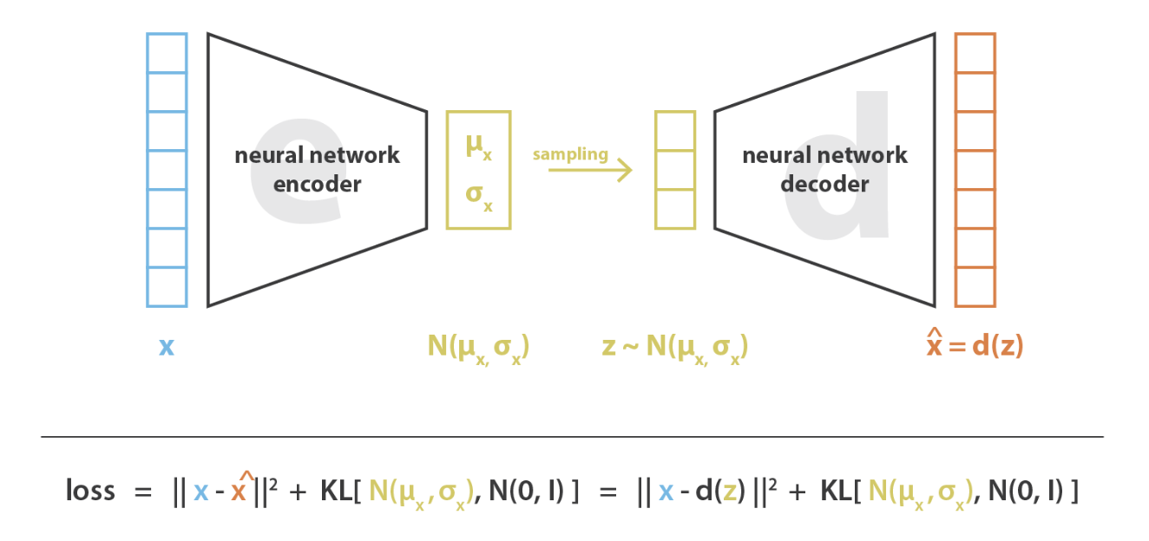
Pollock deep learning architecture
Beta-Variational Autoencoder (B-VAE) followed by a random forest classifier
expression counts
reconstructed expression counts
cell embedding
scRNA-seq expression for a single cell
Random Forest Classifier
Cell type prediction

Slide 7
Beta-Variational Autoencoder (B-VAE)
Deep learning based dimensionality reduction technique
expression counts
reconstructed expression counts
cell embedding
towardsdatascience.com

Slide 8
Beta-Variational Autoencoder (B-VAE)
expression counts
reconstructed expression counts
cell embedding

Slide 9
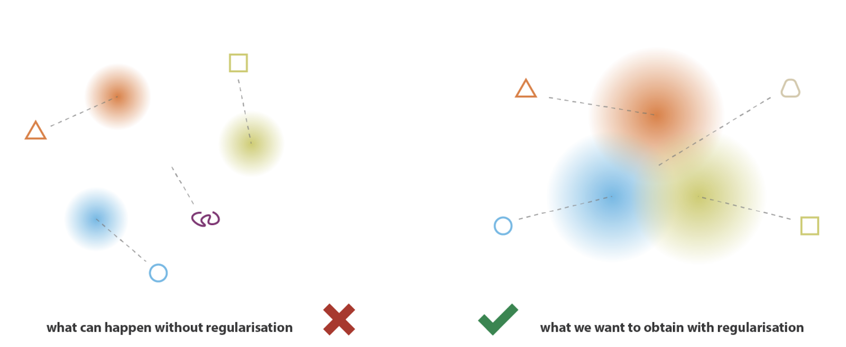
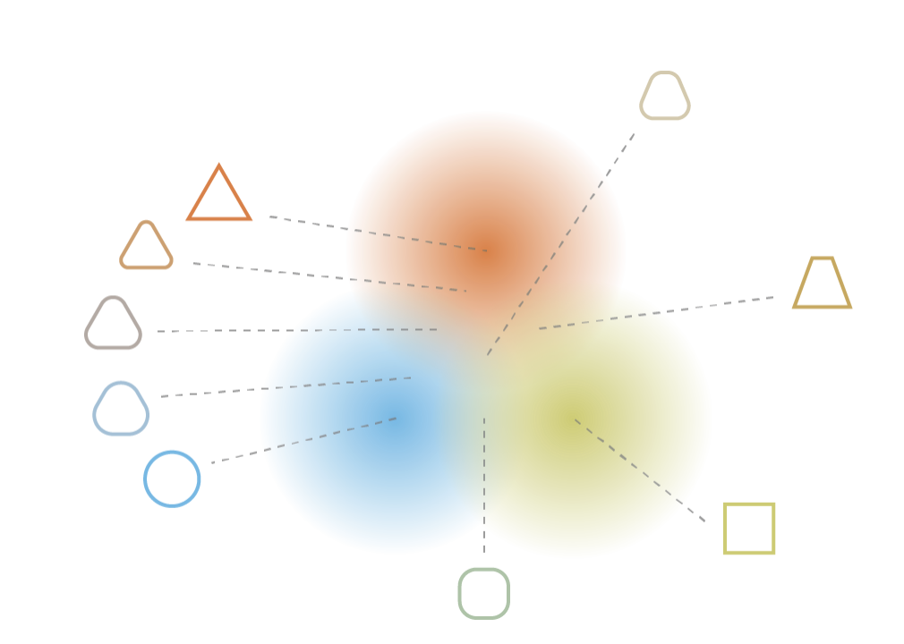
VAEs generate a more meaningful cell embedding
PCA
B-VAE

Slide 10
Advantages of B-VAE cell embedding
expression
reconstructed expression
cell embedding
Smoothness: incremental changes in the cell embedding produce smooth changes in the expression reconstruction
Parsimony: compress information into as few dimensions as possible
Axis-Alignment: main axes of data variability are encoded to the dimensions of the cell embedding
End result is a more generalizable cell embedding, which in turn leads to a more generalizable model

Slide 11
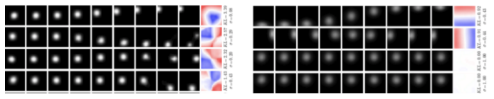
Vanilla Autoencoder
B-VAE

Slide 12
Random Forest Classifier
expression counts
reconstructed expression counts
cell embedding
scRNA-seq expression for a single cell
Random Forest Classifier
Cell type prediction

Slide 13
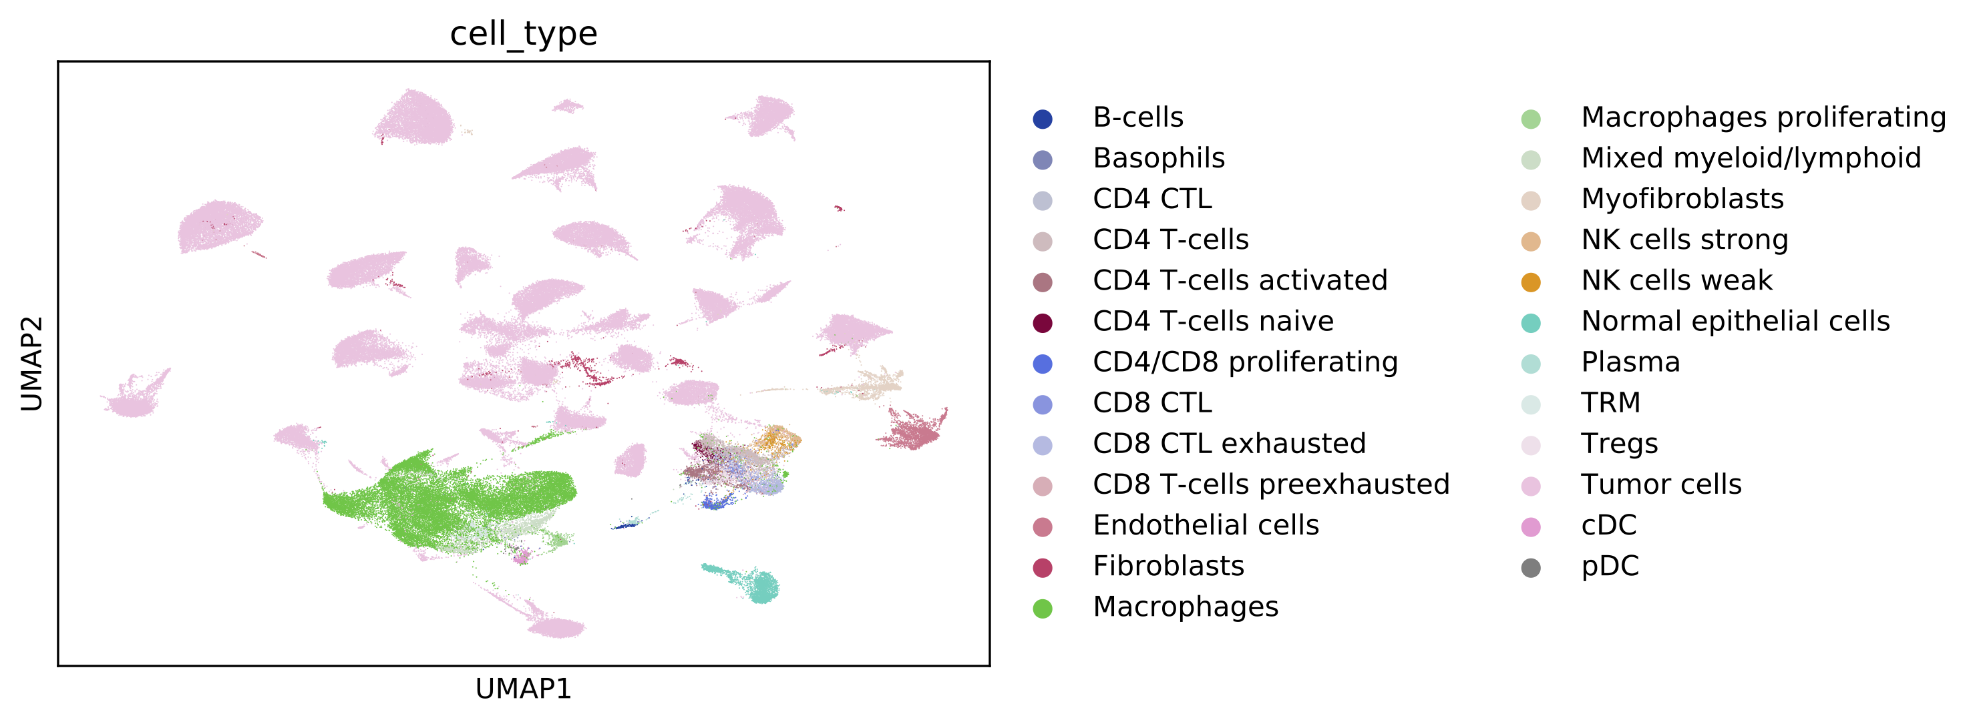
snRNA-seq CCRCC immune cell states example

Slide 14
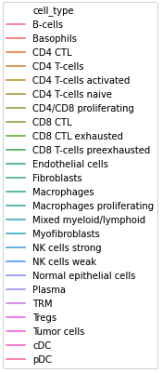
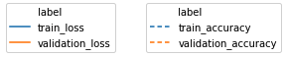
Performance across model training

Slide 15
Model Accuracy
Hand annotated
Predicted

Slide 16
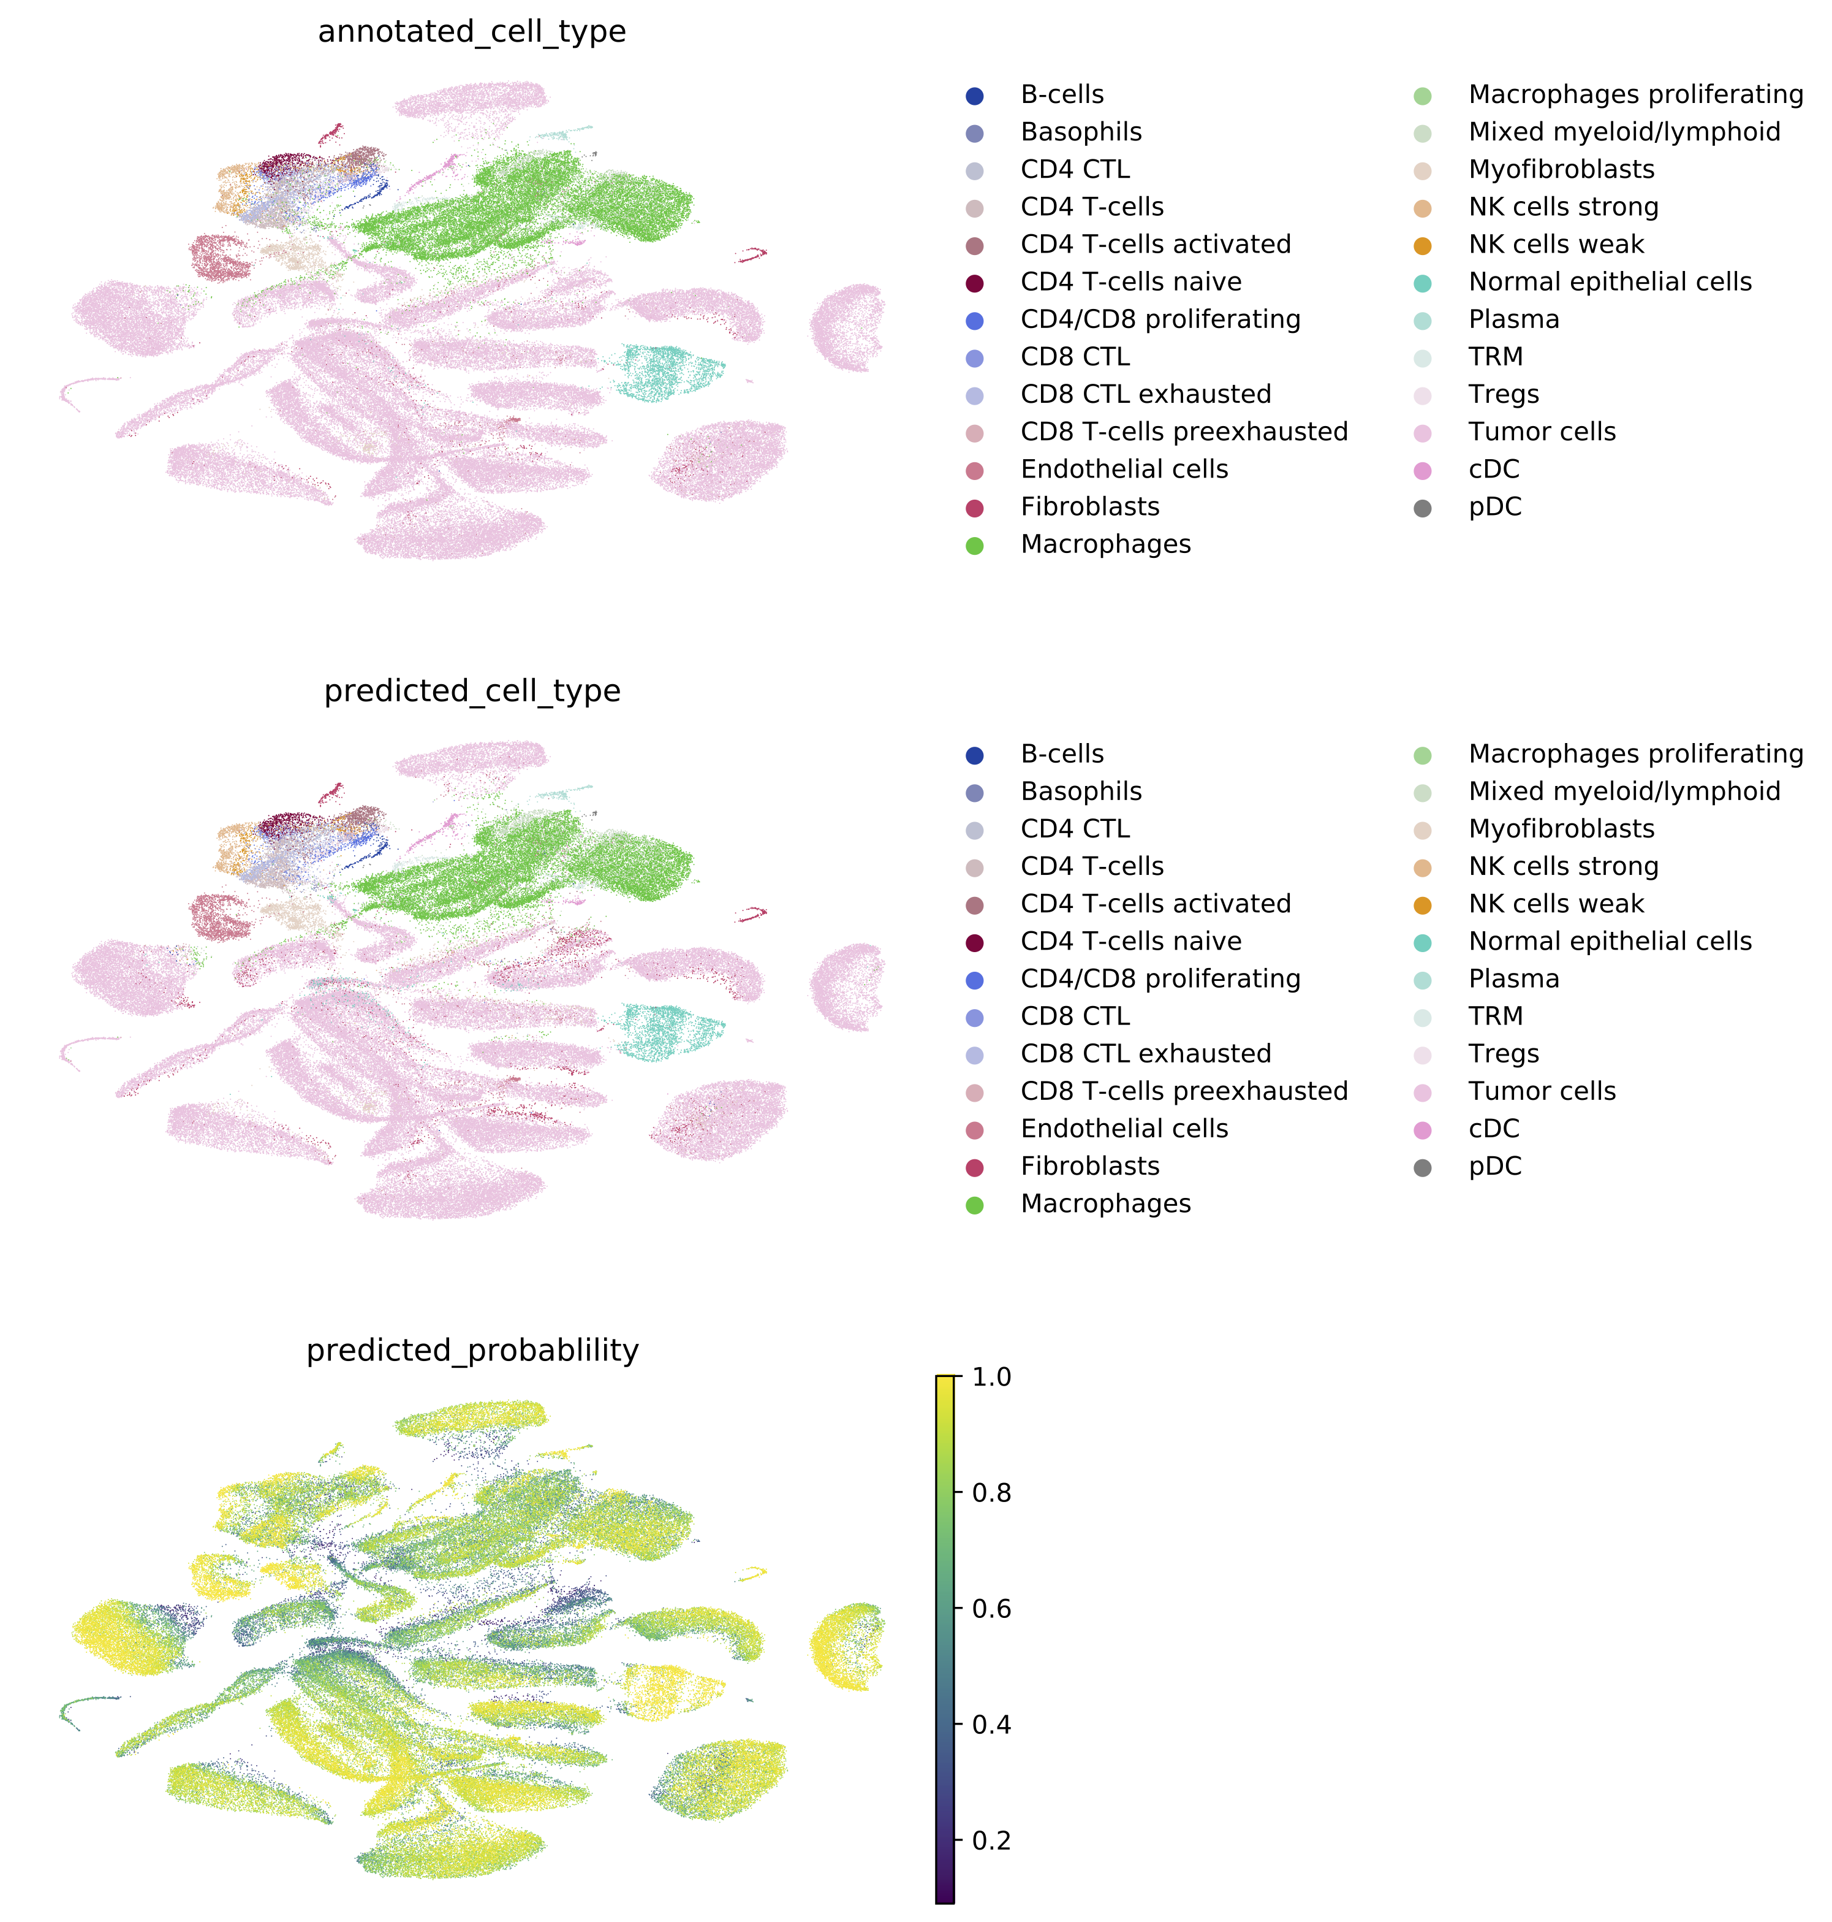
Visualization VAE embeddings and predicted cell types
Gene expression
Reconstructed gene expression
UMAP dimensionality reduction

Slide 17
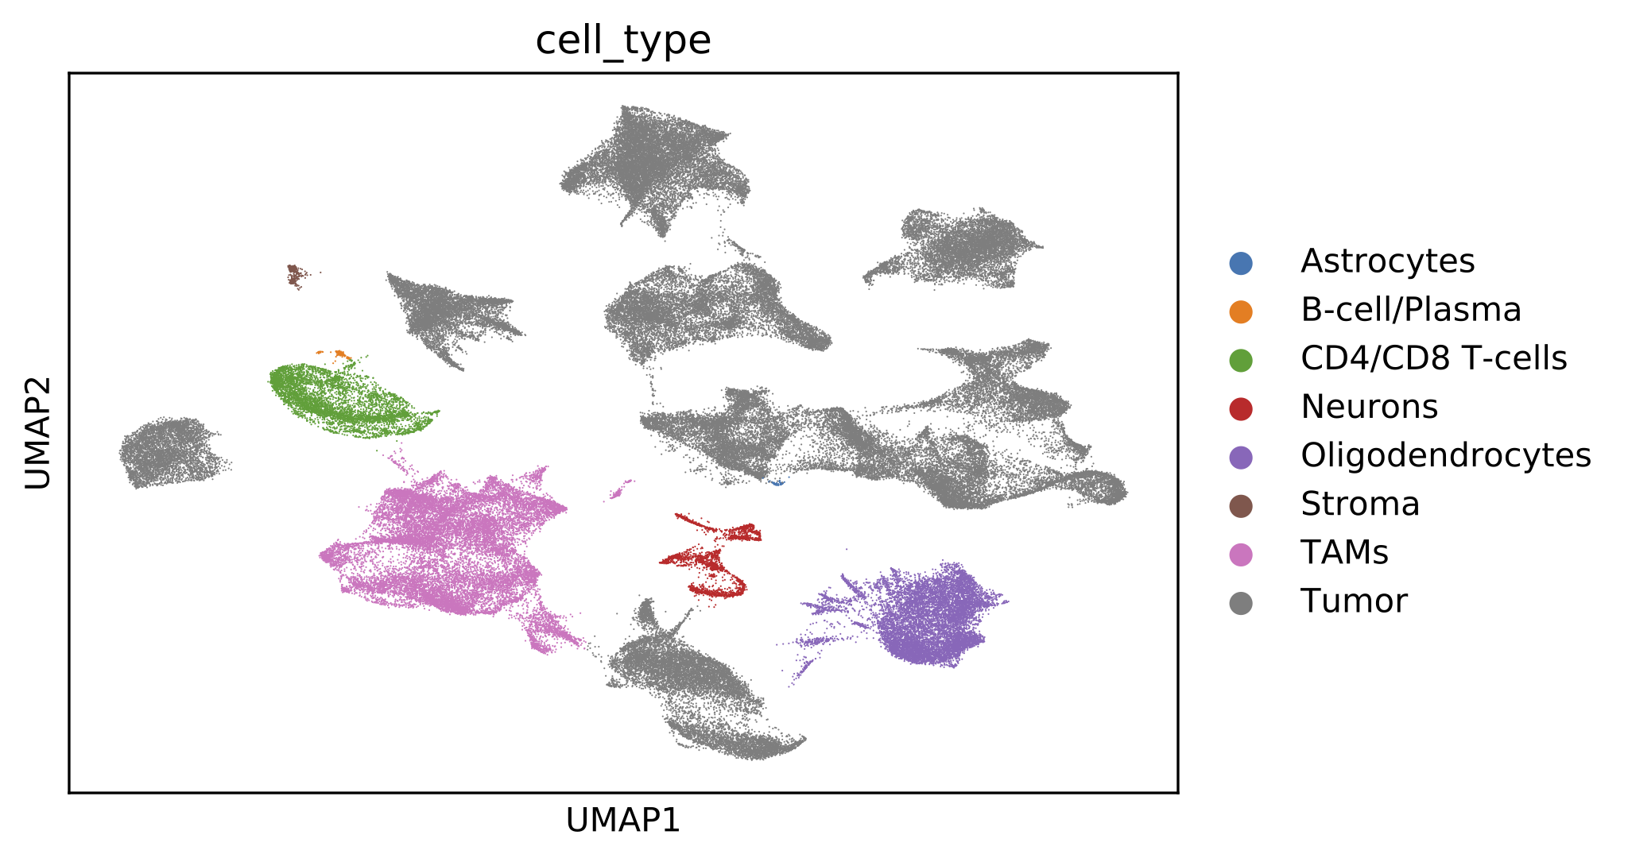
Use trained model to classify snRNA-seq GBM cells

Slide 18
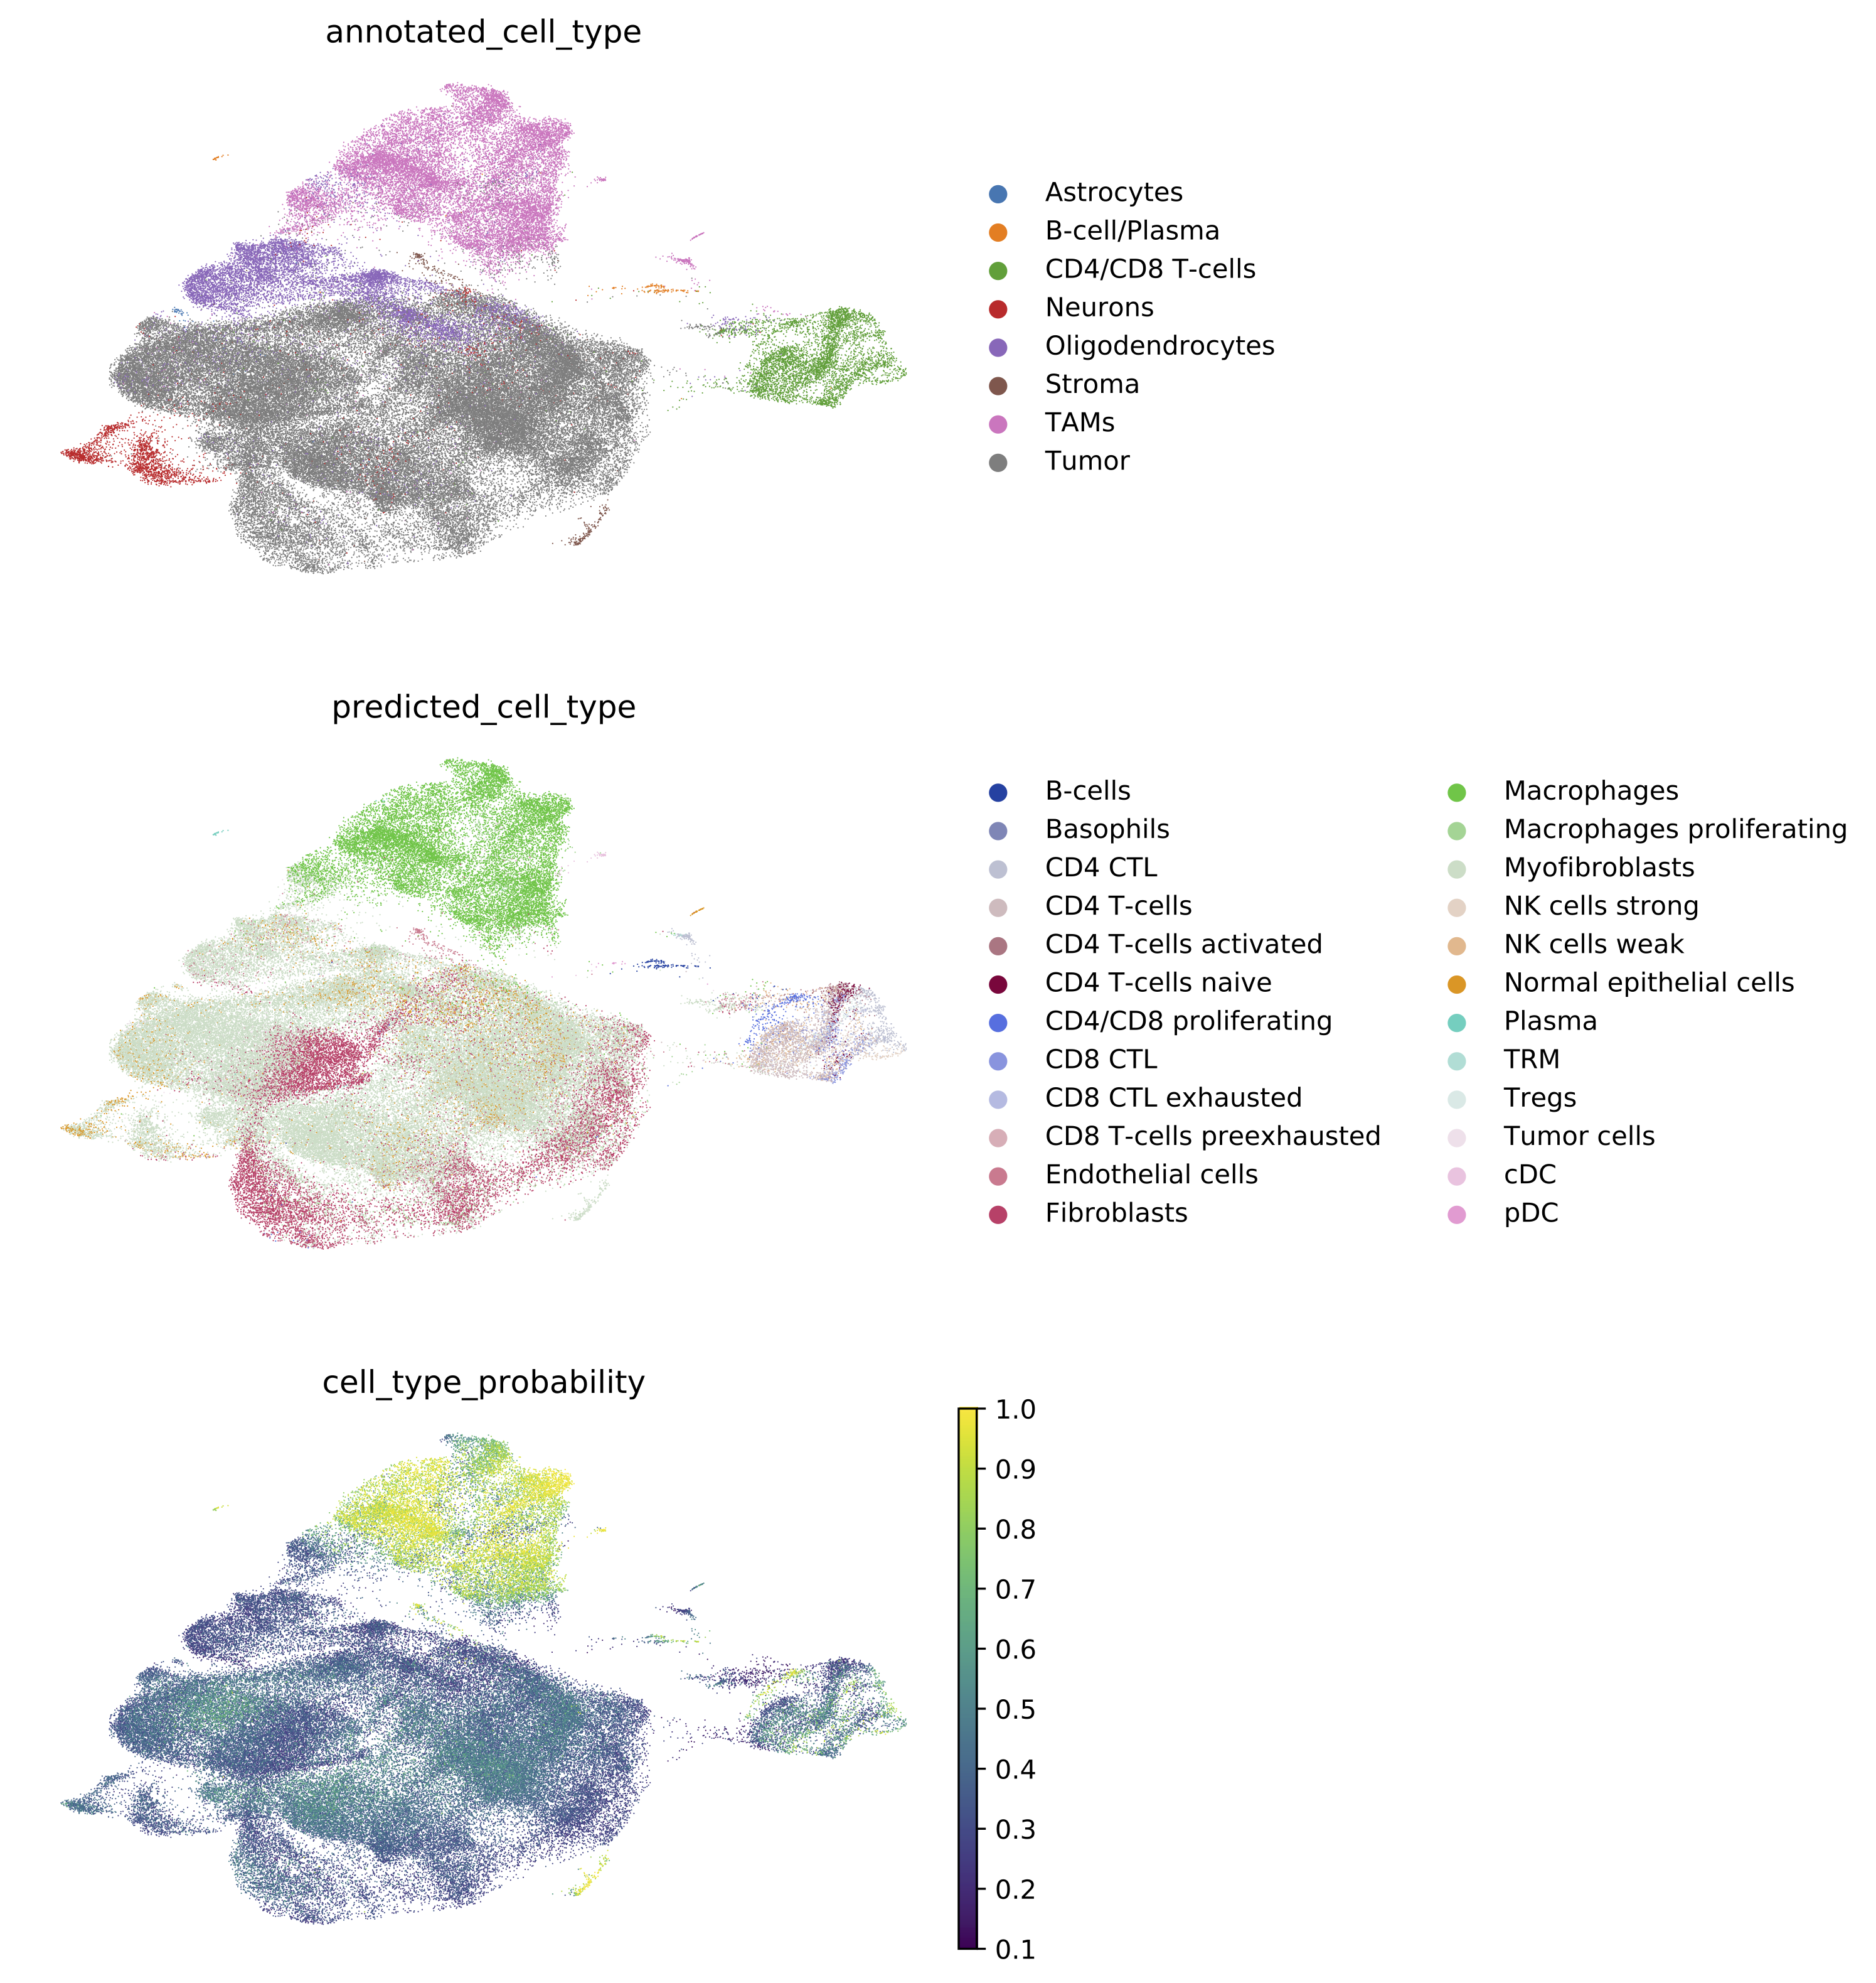
Visualization VAE embeddings and predicted cell types
Gene expression
Reconstructed gene expression
UMAP dimensionality reduction

Slide 19
T/NK cell states

Slide 20
Macrophages/B-cells/DC

Slide 21
Quick DEMO

Slide 22

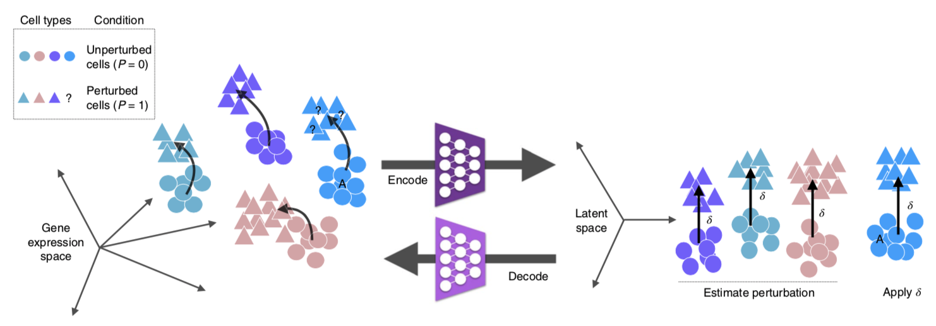
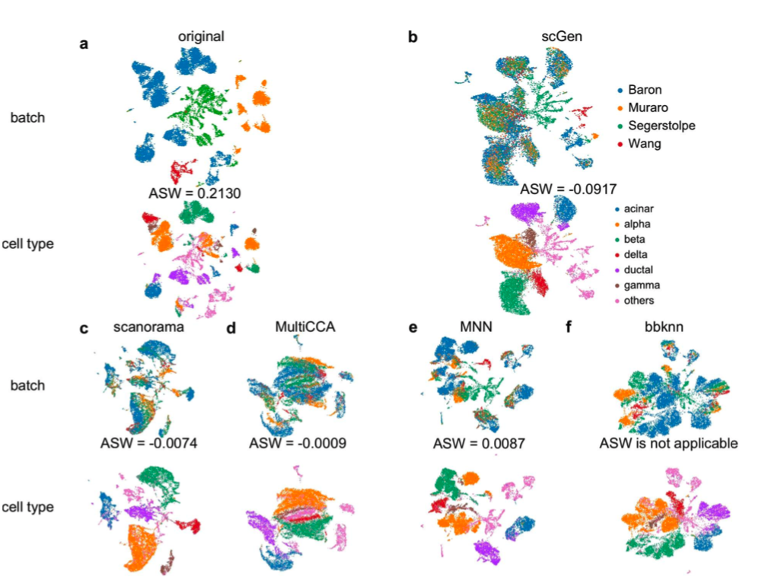
Future Directions
Cell perturbation response
Interrogate differences in cell populations
For example, quantify a ”stem-like” cell profile and extend across different tumor datasets
Batch correction
Develop plug-and-play modules for a variety of tumor/cell/tissue types

Slide 23
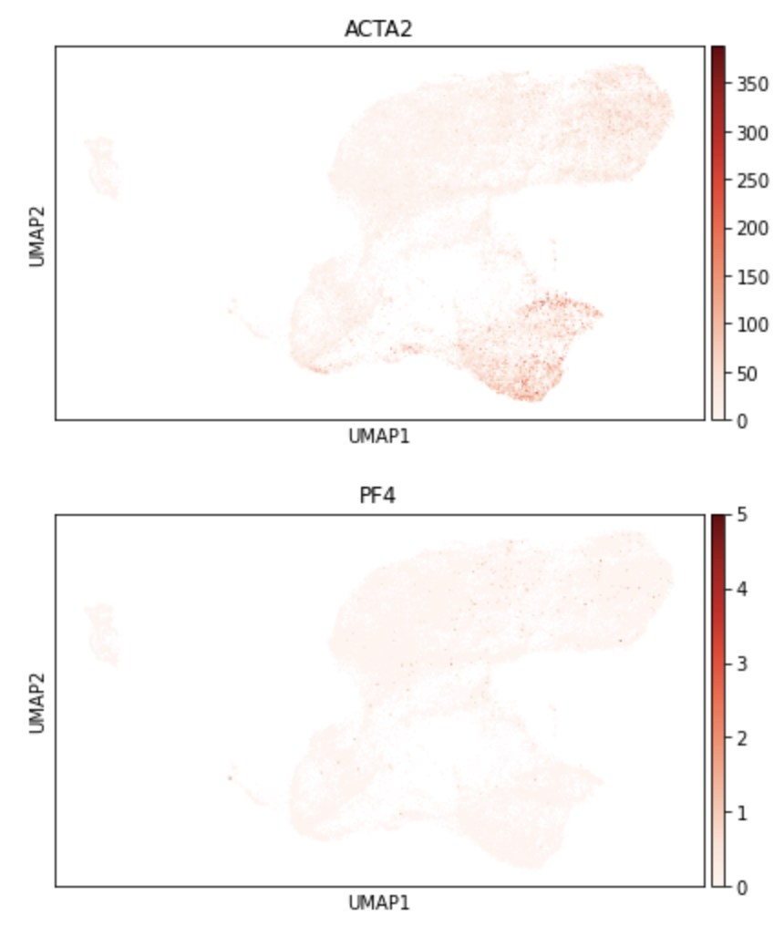
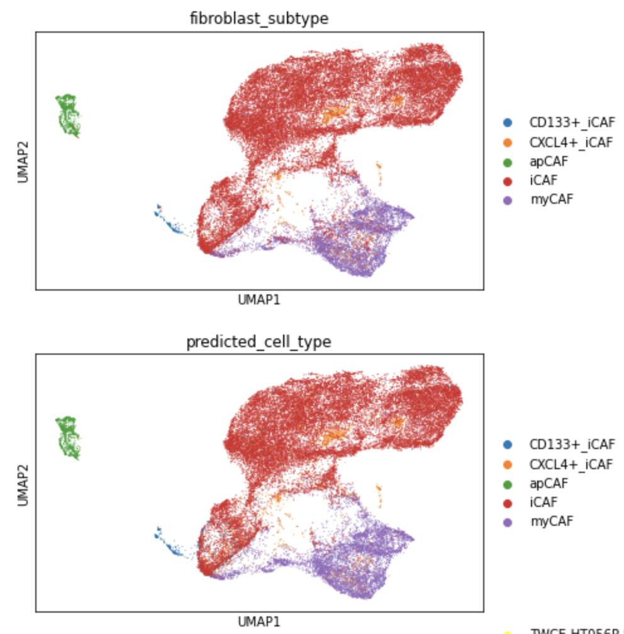
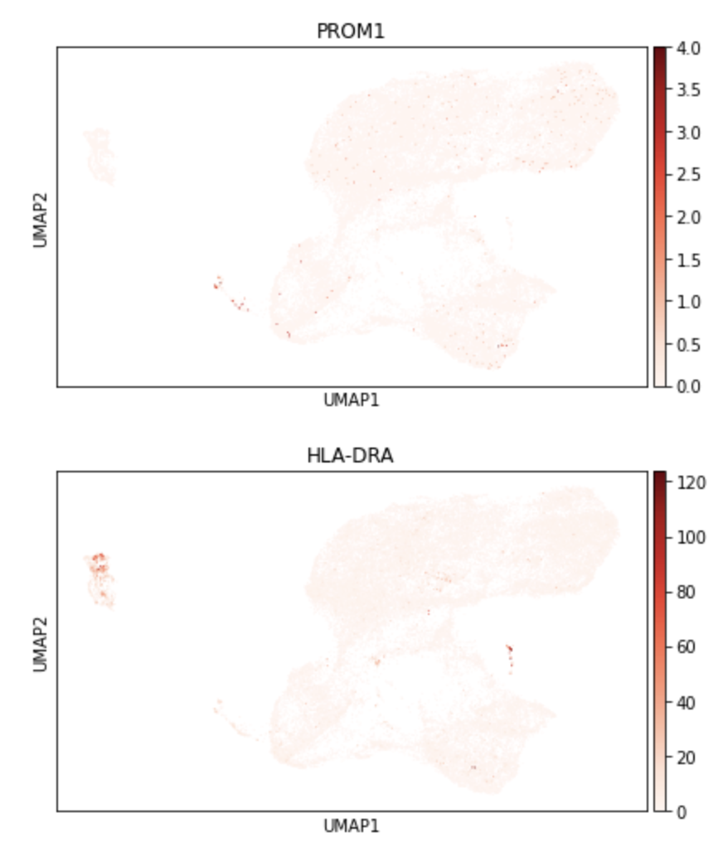
CAF states

